Slide 1
Time Spent on Mathematics vs Programming
DATA 211 Course Project
Natnael Berhanu
December 12, 2024

Slide 2
Objective
Objective: Analyze daily study time for Mathematics and Programming classes.
Key Question: Is the average time spent studying Programming greater than Mathematics?

Slide 3
Hypothesis Testing
Claim: The mean time spent on Programming is greater than the mean time spent on Mathematics.
Variables:
Dependent: Time spent studying (in minutes)
Independent: Subject type (Programming or Mathematics)

Slide 4
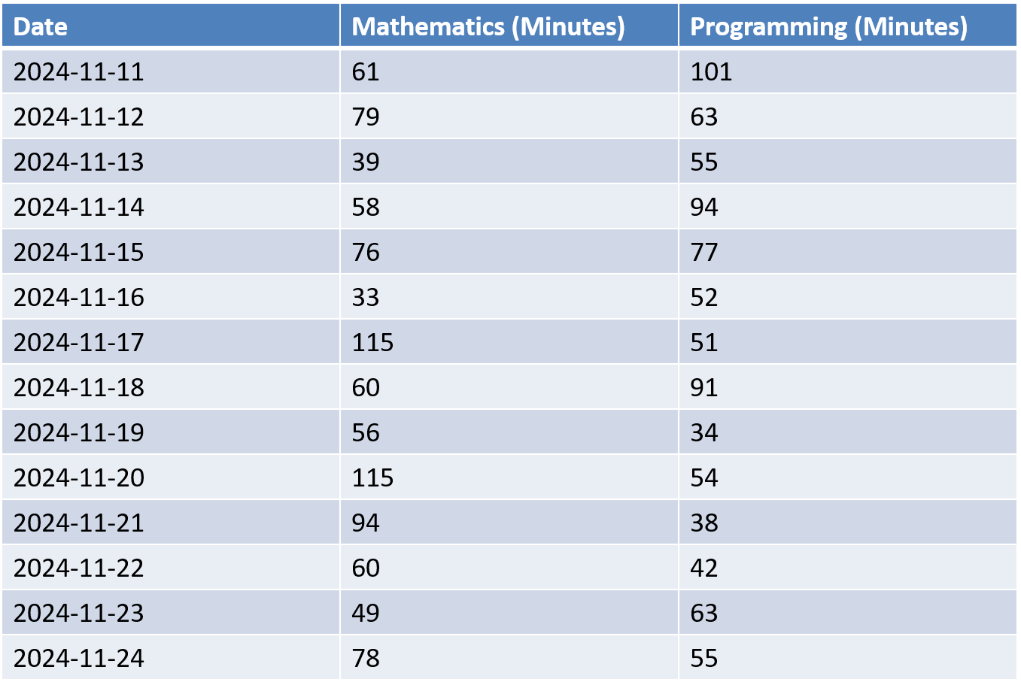
Data Collection
Period Analyzed: Two weeks (Nov 10, 2024 – Nov 24, 2024) Subjects:
Mathematics: Topics include Statistics and Discrete Mathematics.
Programming: Topics include Computational Thinking With Programming and Data Visualization.

Slide 5
Hypothesis Testing
Null Hypothesis (H₀): The average time spent on Programming is less than or equal to the average time spent on Mathematics. H0: μProgramming ≤ μMathematics​
Alternative Hypothesis (Hₐ): The average time spent on Programming is greater than the average time spent on Mathematics. Ha: μProgramming > μMathematics

Slide 6
Hypothesis Testing
t-statistic: -0.84031
Degrees of Freedom (df): 25.228
p-value: 0.7957
95% Confidence Interval: [-22.3072, Inf]
Sample Means:
mean of x (Programming): 62.14 minutes
mean of y (Mathematics): 69.50 minutes

Slide 7
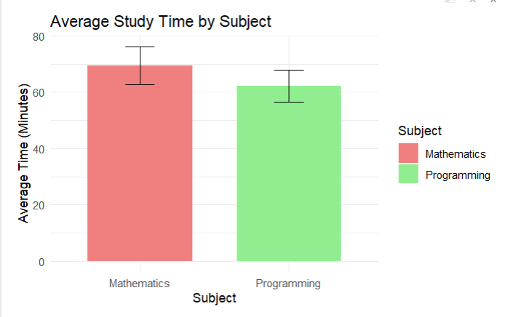
Visualization 1: Average Study Time by Subject

Slide 8
CONCLUSION
Since the p-value (0.7957) is greater than 0.05, we cannot reject the null hypothesis.
Although the data shows that I spent, on average, more time studying Mathematics (69.50 minutes) compared to Programming (62.14 minutes), this difference is not statistically significant.
This means the observed variation in study times is likely due to random chance rather than a meaningful difference in study habits.

Slide 9
GitHub link
Natnael010/Data-211-01

